Slide 1



Centralised Real-Time KPI Dashboard
CODE VERSE HACKATHON 2025
405Found
Members: Om Varma(TL) , Om Patil , Anway Shimpne, Pralhad Chape

Slide 2

The Challenge: Fragmented Campaign Reporting
Scattered Insights
Delayed Decisions
Campaign performance data is spread across numerous disparate tools and platforms.
Lack of a centralised view leads to slow reporting cycles and hampers timely strategic adjustments.
Fragmented View
KPI BlindSpot
Inconsistent data formats and manual aggregation result in a disjointed understanding of overall performance.
Hard to track KPI’s like clicks, impressions, conversions and ROI(Return on Investment) in real time.

Slide 3
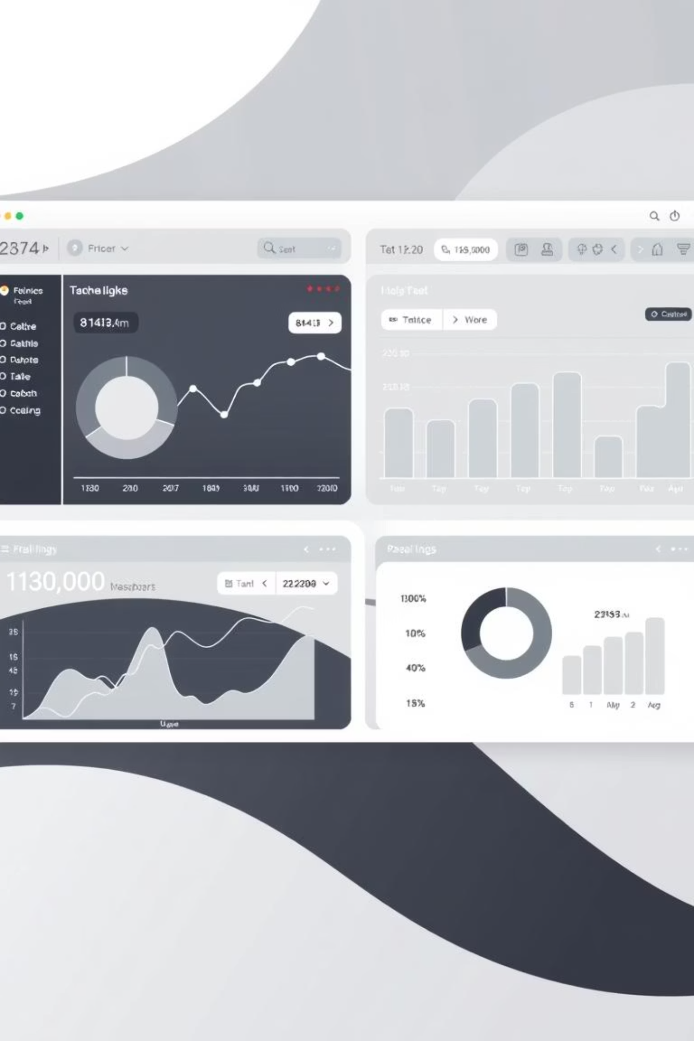



Our Objective: Unified & Actionable Insights
Real-Time Visibility
To provide instant access to consolidated campaign Key Performance Indicators (KPIs).
Accelerated Decision-Making
To empower stakeholders with immediate, data-driven insights for faster, more effective strategies.
Optimised Performance
To enhance overall campaign efficiency and maximise return on investment.

Slide 4
Proposed Solution: Centralised Real-Time KPI Dashboard
Scattered Insights
Data Cleaning & Validation:
Real-Time Data Updates:
Integrates campaign data from multiple sources (Google Ads, Facebook Ads, internal tools, CSVs)
Eliminates fragmented reporting
.
Ensures accuracy and consistency of KPIs
Removes duplicates and errors from raw data
Automatically fetches the latest campaign metrics
Reduces delays in decision-making.
.
KPI Computation:
Visualization & Reporting:
Predictive Insights:
Calculates essential metrics like CTR, conversions, ROI, and spend efficiency
Provides standardized insights across campaigns
Interactive charts, tables, and filters for easy analysis
Customizable dashboards for different stakeholders
Uses ML/analytics models to forecast campaign performance
Highlights potential issues and opportunities
"One source of truth for all your campaign performance."

Slide 5





Key Features
Data Ingestion
Data Processing
KPI Computation
Seamlessly collect data from CSV, APIs (Google Ads, Facebook Ads, etc.), and internal tools.
Robust cleaning and validation mechanisms ensure data accuracy and reliability.
Automated calculation of critical KPIs: CTR, conversions, spend efficiency, ROI.
Dynamic Visuals
Performance Prediction
Interactive charts, tables, and filters for deep dive analysis and customisable views.
Leveraging machine learning for accurate forecasting of campaign outcomes.

Slide 6
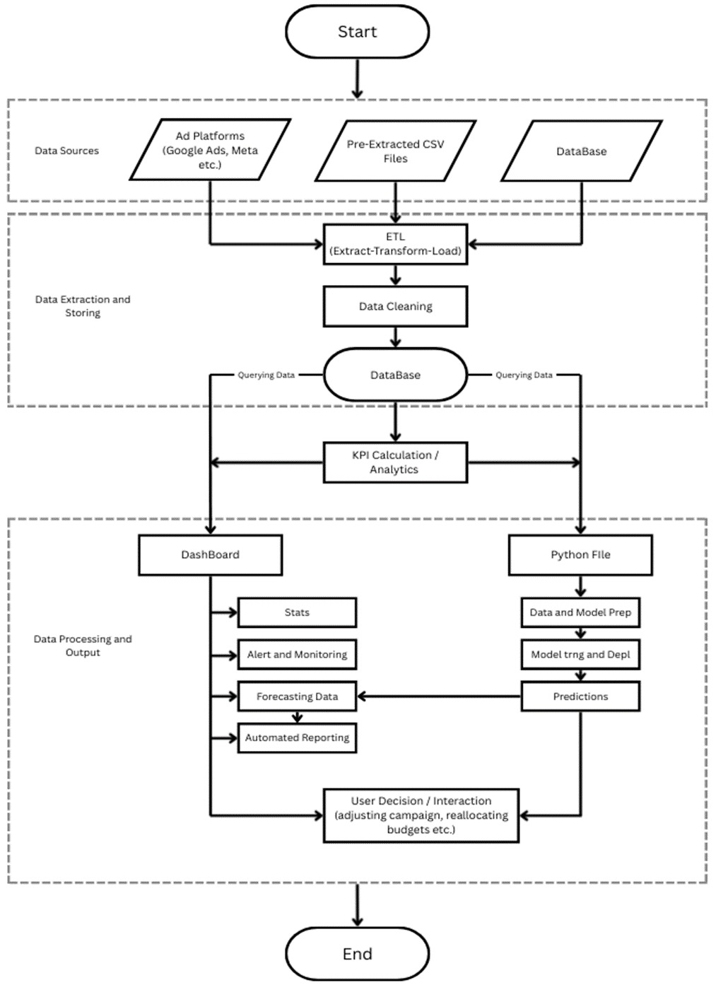





Technical Approach: Building the Engine
Data Sources
Automated scripts and API connectors for real-time aggregation from various sources.
Data Extraction and Storing
Data warehousing and transformation pipelines for cleaning, validation, and KPI derivation.
Data Pre-Processing and Output
Interactive dashboard built with modern frameworks, offering customisable charts and tables.
Predictive Module
Integration of ML models for trend analysis and future campaign performance forecasting.

Slide 7



Benefits & Impact: Driving Success
Improved ROI
Strategic insights lead to better budget allocation and higher returns.
Enhanced Efficiency
Automated processes reduce manual effort and operational errors.
Faster Decisions
Real-time data empowers agile and informed strategic shifts.
Real-Time Visibility
Comprehensive, up-to-the-minute overview of campaign health.

Slide 8
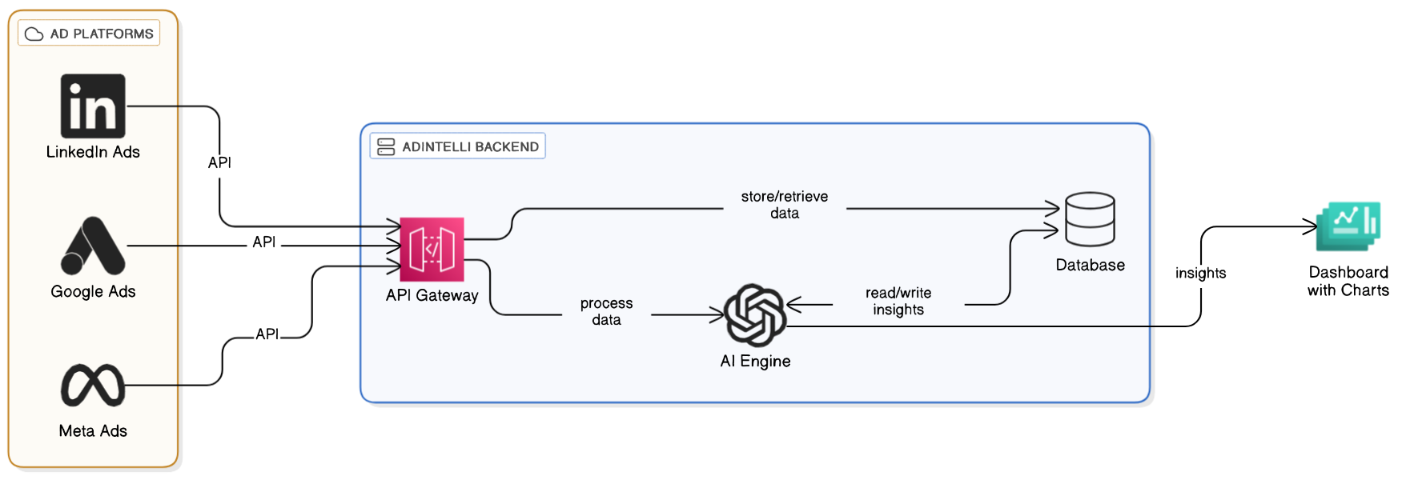
Architecture System Diagram
Scenario:
A marketing team notices a drop in CTR for their Instagram campaign.
Dashboard Action:
Dashboard flags declining CTR and rising cost per acquisition (CPA).
Visualisations quickly pinpoint specific ad creatives underperforming.
Predictive analytics suggests pausing low-performing ads and reallocating budget.
Result: Rapid identification of issues and immediate corrective action, preventing significant budget waste.

Slide 9
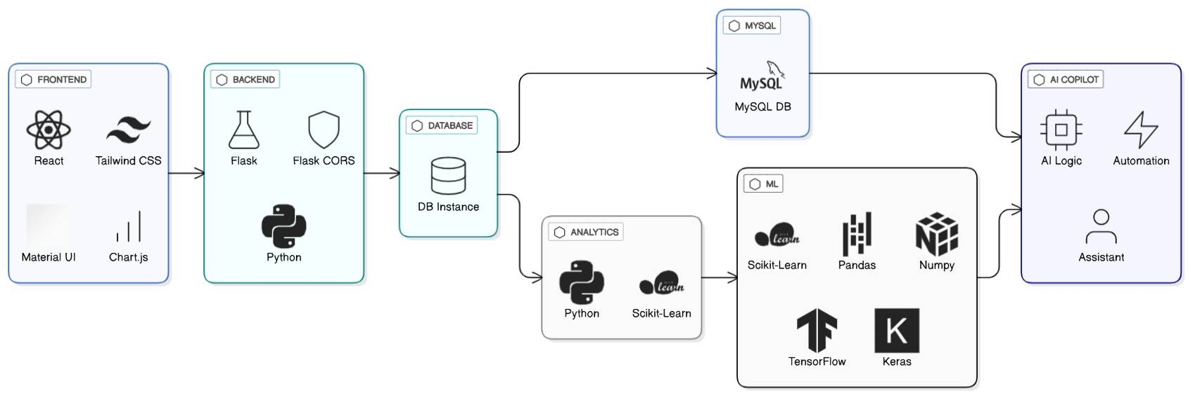
Tech Stack
A marketing team notices a drop in CTR for their Instagram campaign.
Dashboard Action:
Dashboard flags declining CTR and rising cost per acquisition (CPA).
Visualisations quickly pinpoint specific ad creatives underperforming.
Predictive analytics suggests pausing low-performing ads and reallocating budget.
Result: Rapid identification of issues and immediate corrective action, preventing significant budget waste.

Slide 10

Feasibility & Challenges
Feasibility:
Centralizing campaign data is practical with ETL, MySQL, and React; existing APIs support
AI-Driven Recommendations
Challenges:
Automated suggestions for campaign optimisation based on real-time data and historical performance.
Data inconsistency, API limitations, large data volume, real-time update delay.

